Slide 1


DEPARTMENT OF COMPUTER SCIENCE AND ENGINEERING
MINING BLOGS FOR EMOTION-DRIVEN ARGUMENTATION USING NLP TECHNIQUES
Batch No: 11
Year/Sem: IV/I
Section: CSE-A
Project Guide:
Mr. Srinivas Goud
Assistant Professor
Team members: B.Vamshi(21P61A0518) B.Akshaya(21P61A0520) A.Ankitha(22P65A0501)

Slide 2
TABLE OF CONTENT | SLIDE NO
ABSTRACT | 3
INTRODUCTION | 4
LITERATURE SURVEY | 5-7
CHALLENGES | 8
PROBLEM STATEMENT | 9
OBJECTIVES | 10
EXISTING SYSTEM | 11
PROPOSED SYSTEM | 12
PROPOSED METHODOLOGY | 13
SYSTEM SPECIFIC REQUIREMENTS | 14
MODULES | 15-16
IMPLEMENTATION | 17-18
RESULTS | 19-20
REFERENCES | 21

Slide 3
ABSTRACT :
In the digital era, Blogs have acquired a key position that is specially meant for
expressing opinions whether they are personal experiences, thoughts or feelings.
The project is intended to extract emotional argumentation from blogs through Natural Language Processing (NLP) techniques.
The purpose is to investigate blog content for emotion and argumentation, as well as
the association between emotion and argumentation.
The project invites natural language processing (NLP) applications to discover the
patterns by which Emotional Appeals in arguing Source Premise Classification influence argumentative strategies, while studying the emotional tones grounding reasoning that are associated with persuasiveness as well.
The insights derived from this could be very useful in studying online conversation, enhancing digital communication strategies and the potential design of emotion-aware
applications for content moderation utilizing sentiment-powered analytics.
Keywords:
Blogs, emotion, argumentation, Natural Language Processing, emotional tones, Source Premise classification.

Slide 4
INTRODUCTION :
It is a very popular notion that with the booming user-generated content, blogs have emerged as an important platform of both emotive and contentious ideas on widespread issues.
Given the emotional tone and patterns of argument in these blogs are crucial for many fields from research to marketing and policy analysis.
In this project, we develop a system that extracts key topics, recognizes emotions and analyzes argumentative structures within blogs.
This AI-based system, based on techniques for 'Latent Dirichlet Allocation' (LDA) topic
modeling, 'GoEmotions' emotion detection, and 'Bidirectional Encoder Representions from Transformers'(BERT) argument mining will analyse how emotions influence arguments in online discourse.
By using LDA,the key topics can be extracted from the blog posts and to figure out various emotions like +ve,-ve or neutral (sentiment analysis); joy,anger,sadness etc. the TextBlob and
BERT comes into picture.
This project provides a practical tool for automated blog analysis that can help researchers, marketers, and content creators make sense of large volumes of unstructured text.

Slide 5
LITERATURE SURVEY :
Reference/Tool | Publication (Year, Author) | Methodology | Pros | Cons | Solution/Overcoming
Latent Dirichlet Allocation (LDA) | Blei, D. M., Ng, A. Y., & Jordan, M. I. (2021) | Introduced LDA for topic modeling | Efficient for topic discovery. | Topics can lack coherence. | Combining emotion and argument analysis for deeper insights.
GoEmotions | Demszky, D.,Movshovitz-Attias, D., Ko, J., et al. (2020) | Developed a fine-grained emotion dataset. | Covers 27 emotions. | May require domain-specific tuning. | Integrating with TextBlob for additional accuracy.
Argumentation Mining | Stede, M., Schneider, J., et al. (2016) | Surveyed argument mining techniques. | Framework for argument detection. | No emotion or topic integration. | Combining argument mining with emotion detection.

Slide 6
BERT | Devlin, J., Chang, M. W., Lee, K., et al. (2019) | Introduced BERT for deep contextual NLP tasks. | State-of-the-art for contextual understanding. | High computational power requirements. | Pre-trained models for efficient use.
TextBlob | Loria, S. (2018) | Created a basic NLP library for sentiment analysis. | Easy to use. | Limited emotion detection. | Enhancing with GoEmotions for detailed emotions.
spaCy | Honnibal, M., & Montani, I. (2017) | Developed spaCy for fast NLP tasks. | Fast and scalable. | Limited in emotion/argument detection. | Combining with advanced models like BERT.

Slide 7
FGensim | Rehurek, R., & Sojka, P. (2010). Software Framework for Topic Modelling with Large Corpora. Proceedings of the LREC 2010. | Created Gensim for topic modeling using LDA. | Efficient for topic discovery. | Doesn’t analyze emotional or argumentative content | Combining LDA with emotion and argument analysis.
Plotly | Plotly Technologies Inc. (2015). Collaborative Data Science. | Created interactive visualization tools for blog analysis. | Interactive and user-friendly. | Visualization alone isn’t analytical. | Tie visualization to output of topic, emotion, and argument analysis.
Flask | Grinberg, M. (2018). Flask Web Development: Developing Web Applications with Python. O'Reilly Media. | Developed Flask for lightweight web applications. | Lightweight and easy to deploy. | Limited for large-scale applications. | Using Flask for prototyping, scalable later.
Emotion Detection | Barros, A., & Doran, C. (2019). Towards Emotion Detection in Text: A Review of Methods and Applications. ACM Computing Surveys (CSUR). | Reviewed emotion detection methods, including advanced models like GoEmotions. | Broad overview of techniques | Doesn’t focus on modern models. | Implement latest models like GoEmotions and TextBlob.

Slide 8
CHALLENGES :
Capturing extreme emotions within complex arguments in blogs can be difficult: Emotions may be thin or twist with argumentative content.
Ensuring that topics generated by LDA are coherent and meaningful can be problematic, with potential for broad or poorly
defined topics.
Efficiently processing large volumes of blog posts while
maintaining accuracy can be resource-intensive.
Integrating various NLP models (LDA, BERT) into a unified system can be complex and require careful alignment.
Implementing real-time analysis for continuous blog data streams can be technically demanding.

Slide 9
PROBLEM STATEMENT :
How can we develop an integrated Natural Language Processing (NLP) system to effectively mine blog posts for key topics, detect nuanced emotional content, and analyze the argumentative structures present? '
The system must handle diverse and large volumes of text, ensure accurate topic coherence, integrate multiple NLP models seamlessly, and potentially provide real-time analysis.

Slide 10
OBJECTIVES
OBJECTIVE :
Topic Extraction:
To develop, implement a system so as to extract and analyze key topics from blog posts using Laten
Dirichlet Allocation (LDA), ensuring that the topics are coherent and meaning.
Emotion Detection:
To create an emotion detection framework to identify and classify a range of
emotions in blog posts, using advanced models such as GoEmotions for nuanced emotion analysis.
Argument Analysis:
To integrate argument mining capabilities to detect and analyze argumentative
structures within blog posts, correlating these structures with detected emotions to understand how
emotional content influences arguments.

Slide 11
EXISTING SYSTEM
EXISTING SYSTEM :
Popular sentiment analysis libraries such as TextBlob and VADER provide primitive sentiment classification, lacking the proper depth of detecting emotions.
LDA is usually used for topic modeling, but it does not take potentially emotional aspects and argument into consideration.
While argument mining tools, many of which are based on models like BERT – aim to discover arguments in text they are not capable to integrated with topic modeling or emotion detection.
While Emotion detection models such as GoEmotions analyses emotions in more detail, these emotion analysis are usually segregated from other text analysis processes.
Interactive, visualization tools like Plotly are used to create charts but are not integrated with the NLP models to create a seamless analysis.

Slide 12
PROPOSED SYSTEM
PROPOSED SYSTEM :
This proposed system uses advanced NLP techniques to effectively observe blog posts completely.
Primary topic extraction in LDA and employs algorithms like GoEmotions for Emotion Detection and BERT based models for Argument Mining
responsibilities.
It also has interactive visualizations with Plotly and an easy to use, Flask web interface where posts can be uploaded and analyzed.
It's a one-stop shop that ties together topic modelling, emotion detection and argument analysis.

Slide 13
PROPOSED METHODOLOGY
PROPOSED METHODOLOGY :
Data Collection:
Collect and preprocess blog posts via text files or URLs.
Topic Modeling:
Use Latent Dirichlet Allocation (LDA) to extract key topics.
Emotion Detection:
Apply TextBlob for sentiment analysis and GoEmotions for detailed emotion classification.
Argument Mining:
Use BERT or BART to detect and analyze argumentative structures.
Visualization:
Implement Plotly to create interactive visualizations and develop a Flask-based web interface to present results.

Slide 14
SYSTEM SPECIFICATION REQUIREMENTS
SYSTEM SPECIFICATION REQUIREMENTS :
SOFTWARE REQUIREMENTS:
Programming Language: Python 3.x
Libraries: Flask, Gensim, NLTK, TextBlob, Hugging Face Transformers, Plotly
Operating System: Windows/Linux/MacOS
Web Framework: Flask (Python-based web framework) Visualization: Plotly for interactive charts
HARDWARE REQUIREMENTS:
Processor: Intel i5 or above RAM: 8GB minimum
Storage: At least 100MB of free disk space
Network: Internet connection for accessing models and dependencies (Hugging Face, etc.)

Slide 15
1.Data Collection : Purpose: Gather blog data from various online sources. Functionality: Interface with APIs or web scraping tools to retrieve blog content. Support for multiple data formats (e.g., JSON, HTML). 2.Data Preprocessing : Purpose: Prepare raw blog data for analysis. Functionality: Tokenization and normalization of text. Handle missing values and remove unnecessary noise. 3.Emotion Detection : Purpose: Analyze blog content for emotional tone. Functionality: Use NLP libraries to detect emotions (e.g., positive, negative, neutral). Generate emotion scores for each blog entry.
MODULES :

Slide 16
4.Argument Extraction : Purpose: Identify and extract arguments from blog posts. Functionality: Implement algorithms to detect key arguments and their relevance. Evaluate argument strength based on supporting evidence. 5.Data Visualization : Purpose : Display a summary of emotions, sentiments, and arguments for all blog. Functionality: Summarize and display trends across blog posts, such as shifts in emotions or dominant arguments over time.
MODULES :

Slide 17
1.Import Required Libraries : Import necessary libraries for Flask, NLTK, Plotly, and any NLP libraries for emotion detection. Load and Process Blog Content. 2.Load and Process Blog Content: Load the uploaded blog content from the text file. Tokenize the text and perform preprocessing such as removing stop words. 3.Emotion Detection: Implement a method to detect emotions using the chosen NLP library. Calculate the distribution of different emotions present in the blog content. 4.Topic Identification: Analyze the content to identify key topics using a basic tokenization approach.
IMPLEMENTATION: ​

Slide 18
5.Argument Analysis: Implement a simple method to analyze arguments in the text, assigning scores to each argument. 6.Visual Data Representation: Prepare data for visual representation using Plotly to create charts for topics, emotions, and arguments. 7.Setup Flask Web Application: Create routes for uploading the blog file and displaying results.Implement a method to handle file uploads securely. 8.Run the Application: Start the Flask application and ensure it runs smoothly, allowing users to interact via the web interface.
IMPLEMENTATION:

Slide 19
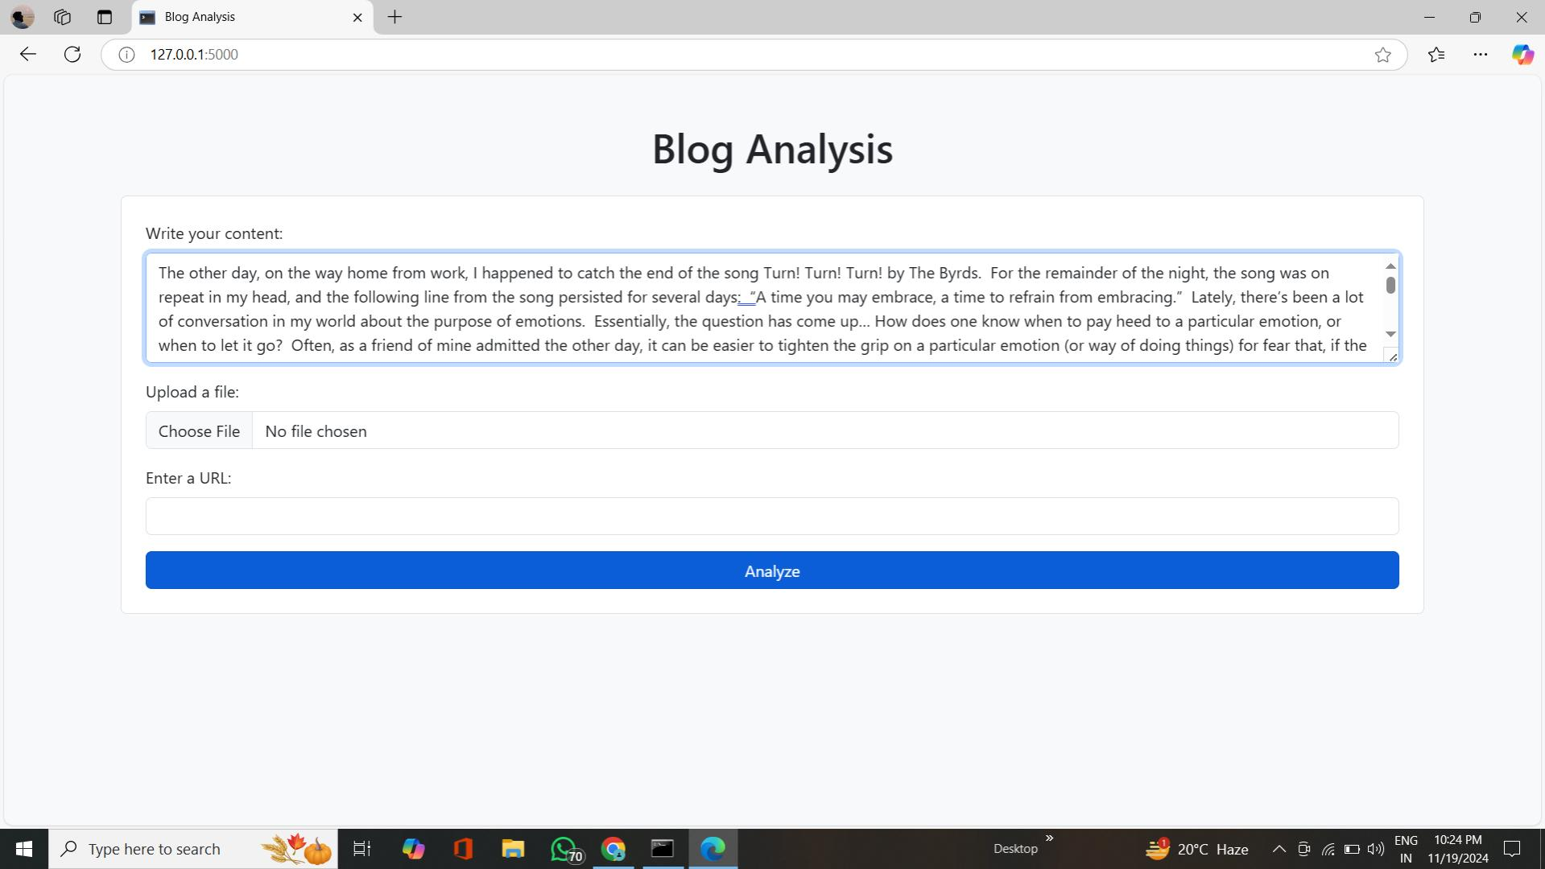
RESULTS: ​

Slide 20
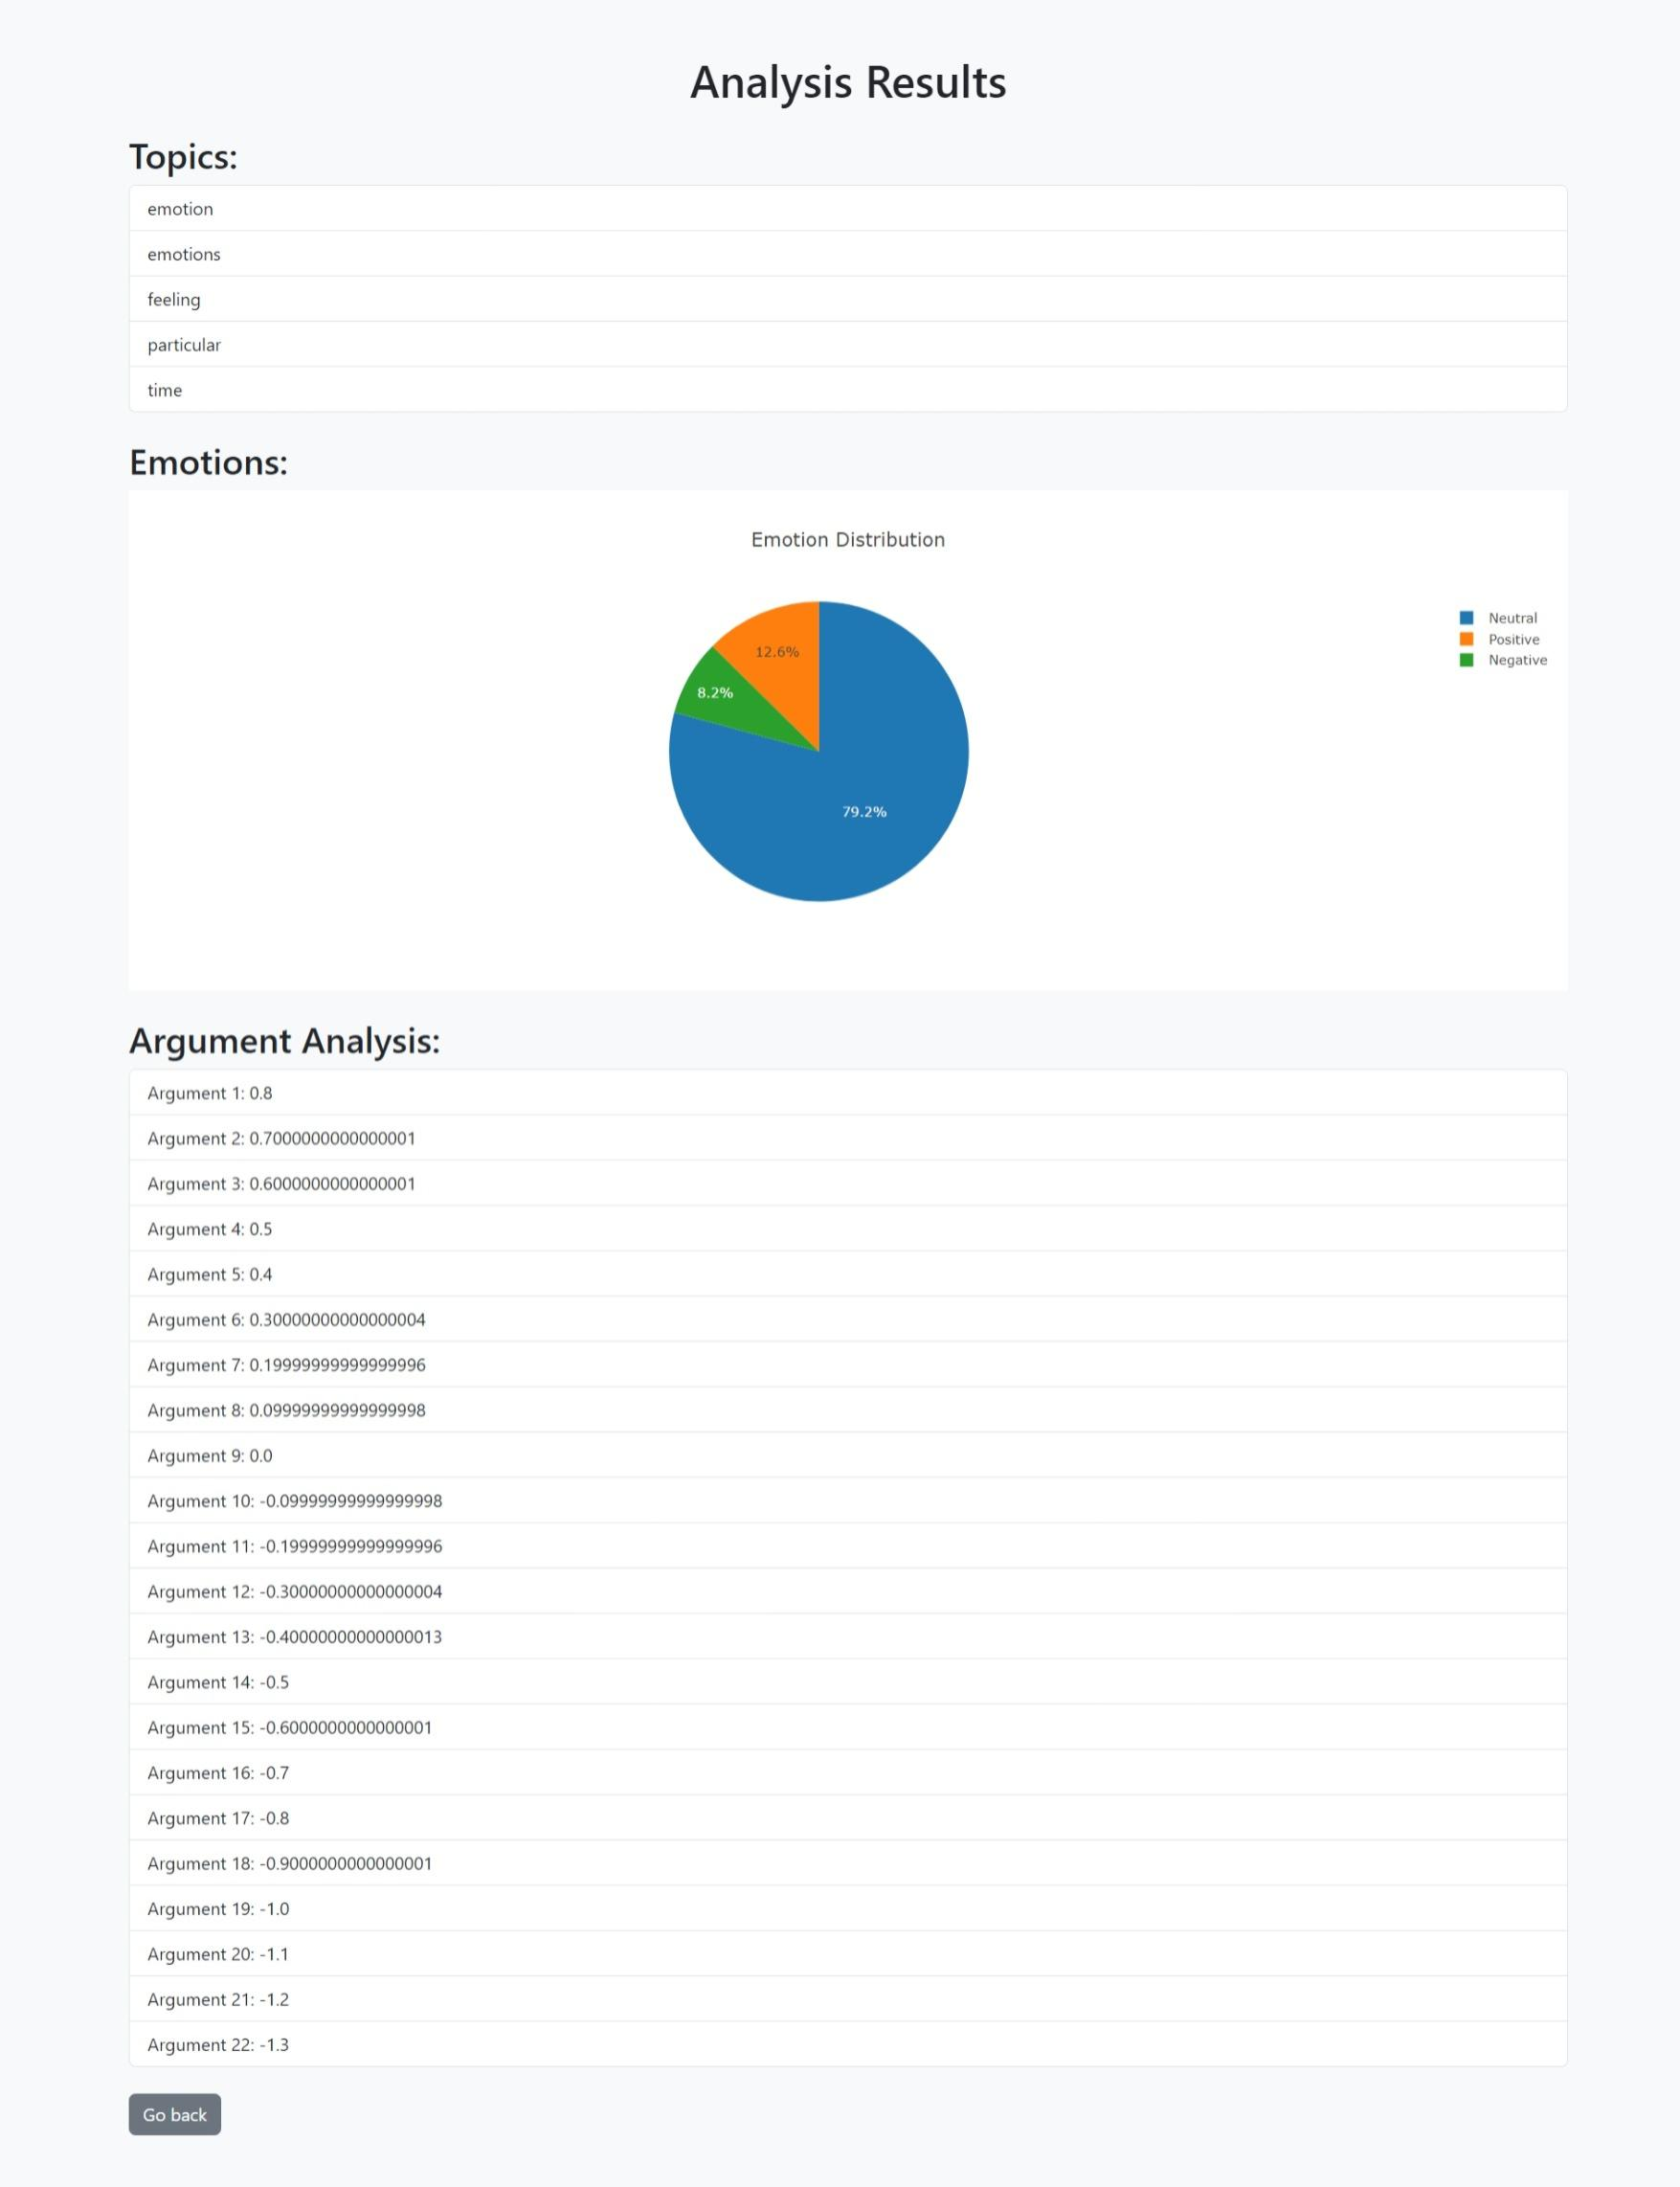
RESULTS: ​

Slide 21
REFERENCES : 1. Blei, D. M., Ng, A. Y., & Jordan, M. I. (2021). Latent Dirichlet Allocation. Journal of Machine Learning Research. 2. GoEmotions, Demszky, D., Movshovitz-Attias, D., Ko, J., et al. (2020). GoEmotions: A Dataset of Fine- Grained Emotions. arXiv preprint arXiv:2005.00547 3. Stede, M., Schneider, J., et al. (2016). Argumentation Mining: A Survey. Computational Linguistics. 4. BERT: Devlin, J., Chang, M. W., Lee, K., et al. (2019). BERT: Pre-training of Deep Bidirectional 5. Transformers for Language Understanding. arXiv preprint arXiv:1810.04805. 6. TextBlob: Loria, S. (2018). TextBlob: Simplified Text Processing. 7. SpaCy: Honnibal, M., & Montani, I. (2017). spaCy 2: Natural Language Understanding with Bloom Embeddings, Convolutional Neural Networks, and Incremental Parsing. 8. FGensim: Rehurek, R., & Sojka, P. (2010). Software Framework for Topic Modelling with Large. Corpora. Proceedings of the LREC 2010 9. Plotly: Plotly Technologies Inc. (2015). Collaborative Data Science. 10. Flask: Grinberg, M. (2018). Flask Web Development: Developing Web Applications with Python. O'Reilly Media. 11. Emotion Detection: Barros, A., & Doran, C. (2019). Towards Emotion Detection in Text: A Review of Methods and Applications. ACM Computing Surveys (CSUR).

Slide 22
THANKYOU

